Slide 1
Thermal Detection

Slide 2
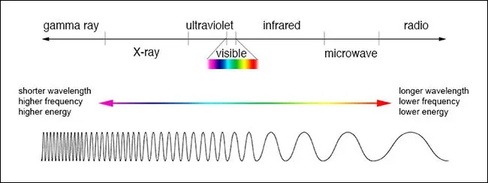
Thermal Imaging

Slide 3
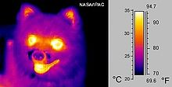
Thermal Imaging

Slide 4
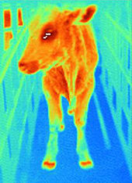
Thermal Imaging

Slide 5
What Is Thermal Imaging?
Infrared thermography is a non-contact sensor technology
Thermal imaging allows you too see an object’s heat radiating off itself.
Thermal cameras record the temperature of various objects in the frame.
Assign each temperature a shade of a color, which lets you see how much heat its radiating compared to objects around it.
Colder temperatures are often given a shade of blue, purple, or green, while warmer temperatures can be assigned a shade of red, orange, or yellow.

Slide 6
Thermal Imaging Uses
Utility and energy companies use it to see where a house might be losing heat through door and window cracks.
Police helicopters use it to locate suspects at night.
Weather stations use it to track storms and hurricanes.
It’s used in the medical field to diagnose different disorders and disease.
And some home security cameras.

Slide 7
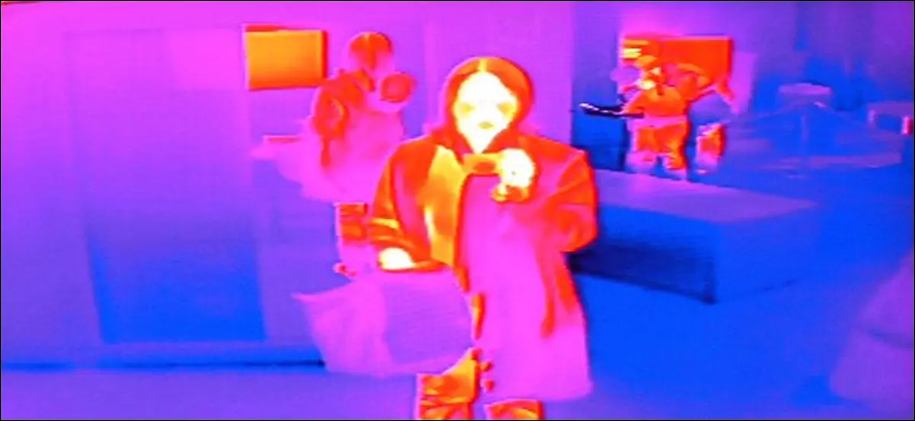
Thermal Imaging

Slide 8
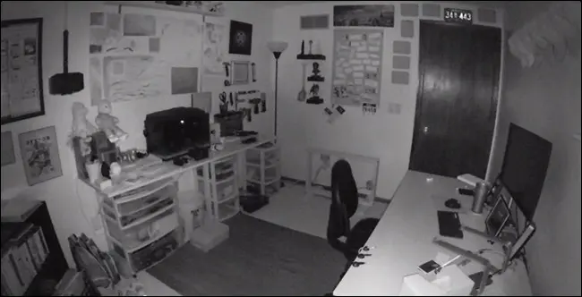
Night Vision

